Slide 1
Ensemble Learning

Slide 2
INTRODUCTION
Ensemble methods is a machine learning technique that combines several base models in order to produce one optimal predictive model.
diverse group of people are likely to make better decisions as compared to individuals.
diverse set of models in comparison to single models.
This diversification in Machine Learning is achieved by a technique called Ensemble Learning.

Slide 3
EXAMPLE
I want to invest in a company XYZ. I am not sure about its performance though. So, I look for advice on whether the stock price will increase more than 6% per annum or not?

Slide 4
SOLUTION
Employee of Company XYZ
Financial Advisor of Company XYZ
Stock Market Trader
Employee of a competitor
Market Research team in same segment
Social Media Expert

Slide 5
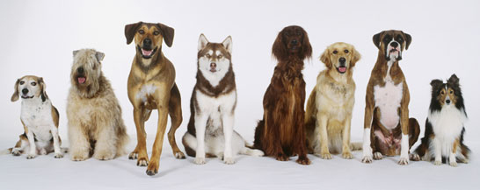

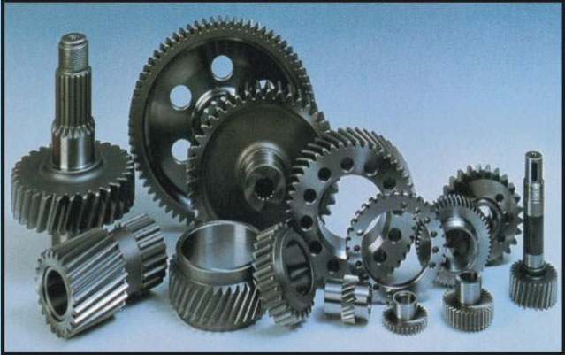
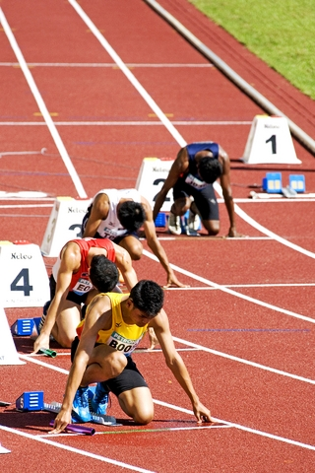
DIFFERENCE BETWEEN MODELS
Population
Hypothesis
Model
Initial Seed

Slide 6
Ensemble Techniques
Max Voting
Averaging
Weighted Averaging

Slide 7
Example
Colleague 1 | Colleague 2 | Colleague 3 | Colleague 4 | Colleague 5 | Final rating
5 | 4 | 5 | 4 | 4 | 4
Colleague 1 | Colleague 2 | Colleague 3 | Colleague 4 | Colleague 5 | Final rating
weight | 0.23 | 0.23 | 0.18 | 0.18 | 0.18
rating | 5 | 4 | 5 | 4 | 4

Slide 8
METHODS
Bagging
considers homogeneous weak learners, learns them independently from each other in parallel and combines them following some kind of deterministic averaging process
Boosting
Considers homogeneous weak learners, learns them sequentially in a very adaptative way (a base model depends on the previous ones) and combines them following a deterministic strategy
Stacking
considers heterogeneous weak learners, learns them in parallel and combines them by training a meta-model to output a prediction based on the different weak models predictions

Slide 9
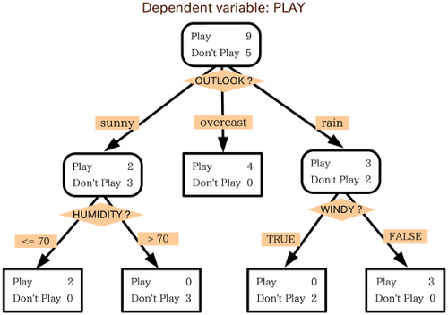

Slide 10
Bagging
Model averaging approach.
bootstrap aggregation. One way to reduce the variance of an estimate is to average together multiple estimates.
models are generated using the same algorithm with random sub-samples of the dataset which are drawn from the original dataset randomly with bootstrap sampling method.
In bootstrap sampling, some original examples appear more than once and some original examples are not present in the sample.

Slide 11
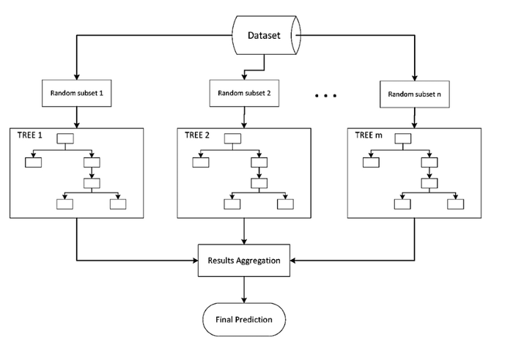

Slide 12
Boosting
build a family of models that are aggregated to obtain a strong learner that performs better.
each model in the sequence is fitted giving more importance to observations in the dataset that were badly handled by the previous models in the sequence.
Adaptive
Gradient

Slide 13
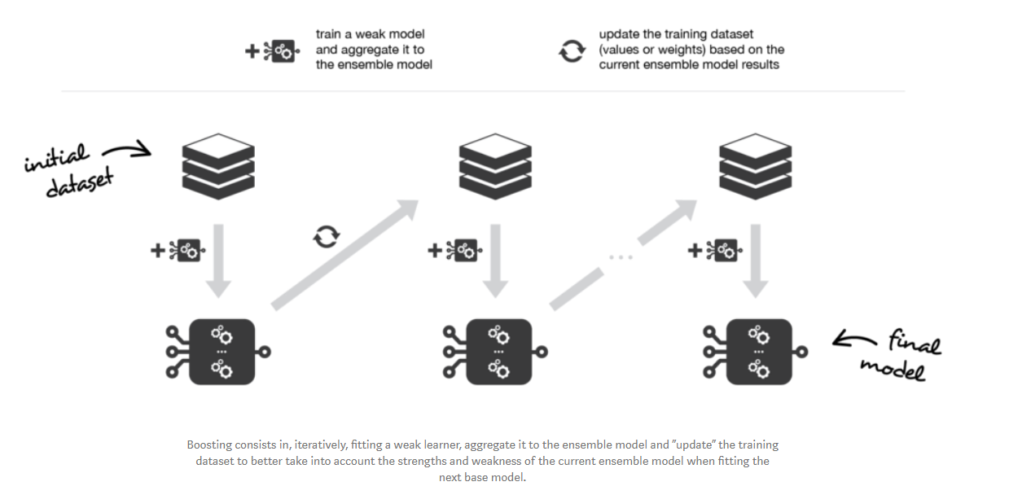

Slide 14
Stacking
Stacking learns to combine the base models using a meta-model
idea of stacking is to learn several different weak learners and combine them by training a meta-model to output predictions based on the multiple predictions returned by weak models.

Slide 15
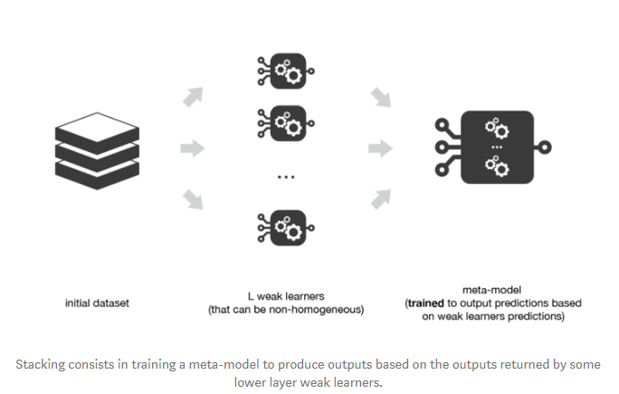

Slide 16
Steps
split the training data in two folds
choose L weak learners and fit them to data of the first fold
for each of the L weak learners, make predictions for observations in the second fold
fit the meta-model on the second fold, using predictions made by the weak learners as input

Slide 17
Multi-levels Stacking
stacking with multiple layers.
For 3-levels stacking
First level (layer), we fit the L weak learners that have been chosen.
Second level, instead of fitting a single meta-model on the weak models predictions (as it was described in the previous subsection) -fit M such meta-models.
Third level Fit a last meta-model that takes as inputs the predictions returned by the M meta-models of the previous level.

Slide 18
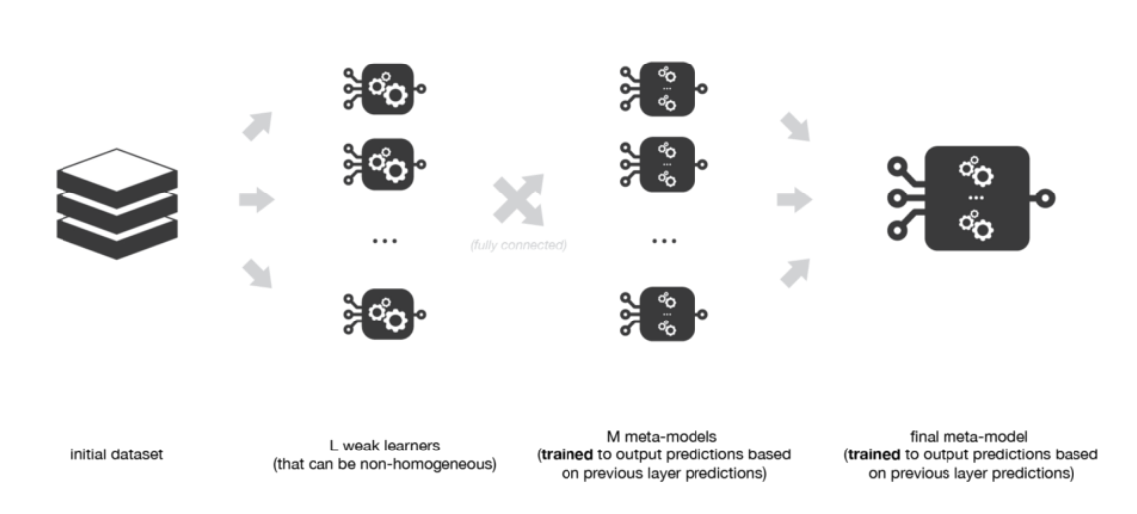

Slide 19
Conclusion
ensemble learning is a machine learning paradigm where multiple models (often called weak learners or base models) are trained to solve the same problem and combined to get better performances
the main hypothesis is that combining weak learners the right way we can obtain more accurate and/or robust models
in bagging methods, several instance of the same base model are trained in parallel (independently from each others) on different bootstrap samples and then aggregated in some kind of “averaging” process
the kind of averaging operation done over the (almost) i.i.d fitted models in bagging methods mainly allows us to obtain an ensemble model with a lower variance than its components: that is why base models with low bias but high variance are well adapted for bagging

Slide 20
in boosting methods, several instance of the same base model are trained sequentially such that, at each iteration, the way to train the current weak learner depends on the previous weak learners and more especially on how they are performing on the data
this iterative strategy of learning used in boosting methods, that adapts to the weaknesses of the previous models to train the current one, mainly allows us to get an ensemble model with a lower bias than its components: that is why weak learners with low variance but high bias are well adapted for boosting
in stacking methods, different weak learners are fitted independently from each others and a meta-model is trained on top of that to predict outputs based on the outputs returned by the base models

Slide 21
Boosting Algorithm
Boosting algorithm tries to build a strong learner (predictive model) from the mistakes of several weaker models.
Starts by creating a model from the training data. Then, you create a second model from the previous one by trying to reduce the errors from the previous model. Models are added sequentially, each correcting its predecessor,
until the training data is predicted perfectly or the maximum number of models have been added.
Boosting basically tries to reduce the bias error which arises when models are not able to identify relevant trends in the data.

Slide 22
Types of Boosting Algorithms
AdaBoost (Adaptive Boosting)
Gradient Tree Boosting
XGBoost

Slide 23
A weak classifier is one that performs better than random guessing, but still performs poorly at designating classes to objects.
best out-of-the-box classifier.
Decision Stumps

Slide 24
Step 1: A weak classifier (e.g. a decision stump) is made on top of the training data based on the weighted samples. Here, the weights of each sample indicate how important it is to be correctly classified. Initially, for the first stump, we give all the samples equal weights.

Slide 25
Step 2: We create a decision stump for each variable and see how well each stump classifies samples to their target classes. For example, in the diagram below we check for Age, Eating Junk Food, and Exercise. We'd look at how many samples are correctly or incorrectly classified as Fit or Unfit for each individual stump.

Slide 26
Step 3: More weight is assigned to the incorrectly classified samples so that they're classified correctly in the next decision stump. Weight is also assigned to each classifier based on the accuracy of the classifier, which means high accuracy = high weight!

Slide 27
Step 4: Reiterate from Step 2 until all the data points have been correctly classified, or the maximum iteration level has been reached.

Slide 28
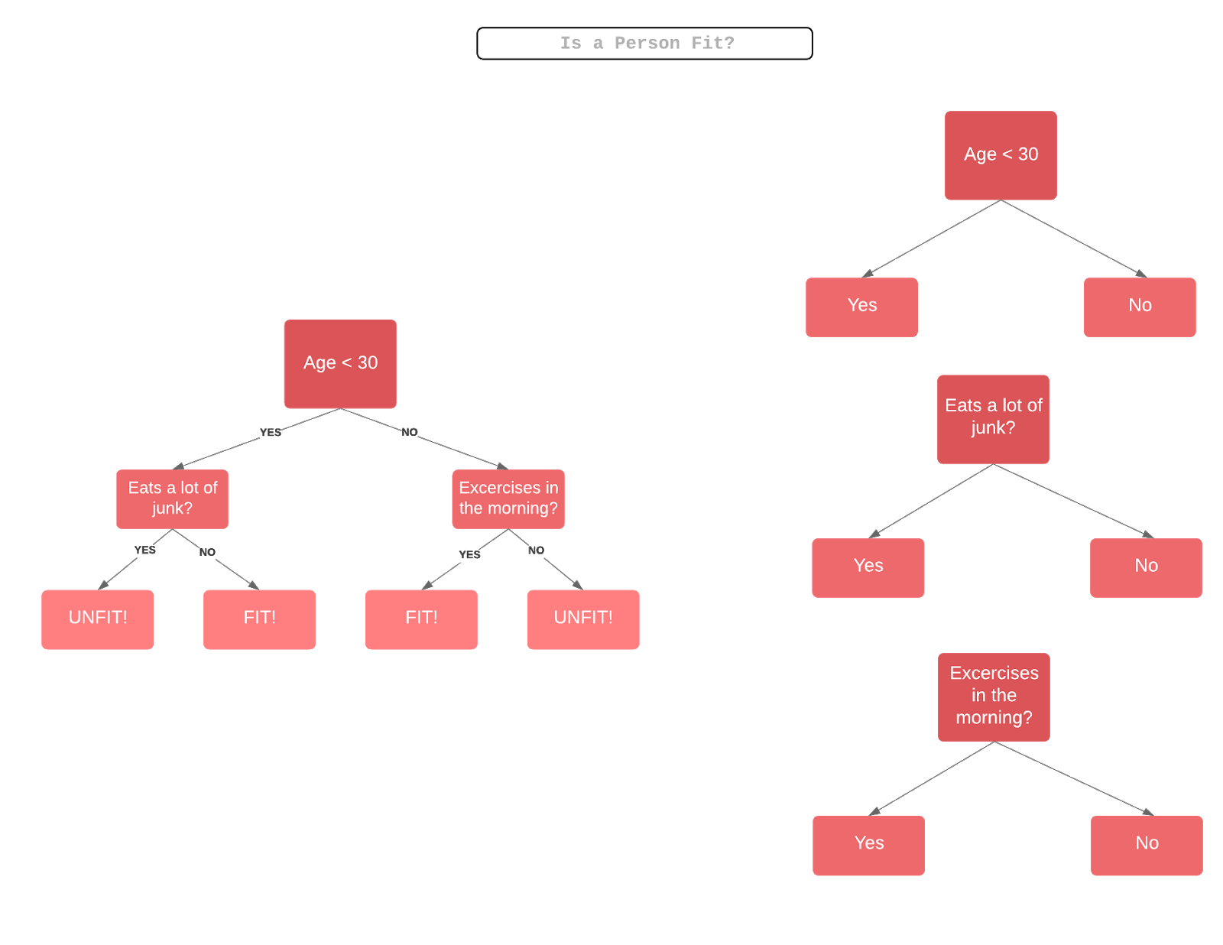

Slide 29

Working
n is the dimension of real numbers, or the number of attributes in our dataset
x is the set of data points
y is the target variable which is either -1 or 1 as it is a binary classification problem, denoting the first or the second class (e.g. Fit vs Not Fit)

Slide 30

Weight initialization
N is the number of data points
weighted samples always sum to 1, so the value of each individual weight will always lie between 0 and 1.

Slide 31


Alpha is how much influence this stump will have in the final classification. Total Error is nothing but the total number of misclassifications for that training set divided by the training set size.

Slide 32
Alpha value
Alpha is positive
when the predicted and the actual output agree (the sample was classified correctly). In this case we decrease the sample weight from what it was before, since we're already performing well.
Alpha is negative
when the predicted output does not agree with the actual class (i.e. the sample is misclassified). In this case we need to increase the sample weight so that the same misclassification does not repeat in the next stump. This is how the stumps are dependent on their predecessors.

Slide 33
Parameter
base_estimator: It is a weak learner used to train the model.
n_estimators: Number of weak learners to train in each iteration.
learning_rate: It contributes to the weights of weak learners. It uses 1 as a default value.

Slide 34
RANDOM FOREST ALORITHM
Random forest is a supervised learning algorithm which is used for both classification as well as regression.
Constructing multiple decision tree during training and voting
Application
Remote sensing
Object detection
Human movement- Dance , Gait etc

Slide 35
Algorithm
Step 1 − First, start with the selection of random samples from a given dataset.
Step 2 − Next, this algorithm will construct a decision tree for every sample. Then it will get the prediction result from every decision tree.
Step 3 − In this step, voting will be performed for every predicted result.
Step 4 − At last, select the most voted prediction result as the final prediction result.

Slide 36
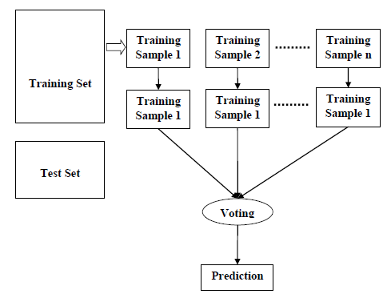

Slide 37
Advantage
It overcomes the problem of overfitting by averaging or combining the results of different decision trees.
Random forests work well for a large range of data items than a single decision tree does.
Random forest has less variance then single decision tree.
Random forests are very flexible and possess very high accuracy.
Scaling of data does not require in random forest algorithm. It maintains good accuracy even after providing data without scaling.
Random Forest algorithms maintains good accuracy even a large proportion of the data is missing.

Slide 38
Disadvantages
Complexity is the main disadvantage of Random forest algorithms.
Construction of Random forests are much harder and time-consuming than decision trees.
More computational resources are required to implement Random Forest algorithm.
It is less intuitive in case when we have a large collection of decision trees.
The prediction process using random forests is very time-consuming in comparison with other algorithms.

Slide 39
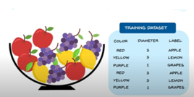

Slide 40
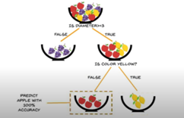

Slide 41
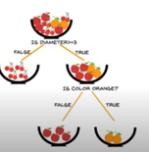
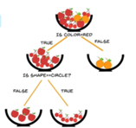
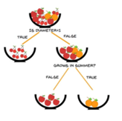

Slide 42
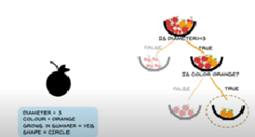
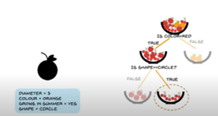

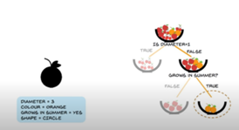

Slide 43
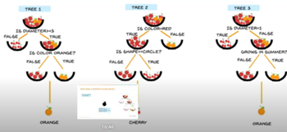

Slide 44
